Slide 1

BADERIA GLOBAL INSTITUTE OF ENGINEERING & MANAGEMENT, JABALPUR
Semester : V
Branch: Computer Science and Engineering
Course Name: Minor Project - I
Course Code: CS508
Presentation on
SMART LEARN STUDIO
0246CS243D18 – Tushar Vadiya
0246CS243D12 – Ketan Vishwakarma
0246CS243D13 – Mohd Nabeel
0246CS243D01– Adesh Soni
ENROLLMENT NUMBER & NAME OF MEMBERS:
Notes:
1

Slide 2
Table of Content
Introduction
Problem Statement
Literature Survey / Existing Systems
Project Objectives
Proposed Solution
Technology Stack
Feasibility Study
Tentative Timeline (Gantt Chart)
Expected Outcomes
References
Baderia Global Institute of Engineering and Management, Jabalpur
2
Notes:
2

Slide 3
Problem Statement
Traditional online learning platforms require instructors to manually design courses, which is time-consuming and inconsistent in quality. Students also struggle to find personalized learning paths aligned with their skill level and goals.
There is a need for a system that automatically generates structured and personalized courses using Al, making course creation faster for instructors and learning more adaptive for students.
Baderia Global Institute of Engineering and Management, Jabalpur
3

Slide 4
Literature Survey
CURRENT SOLUTIONS (WHAT EXISTS NOW)
Platforms like Coursera and Udemy offer many courses for students but do not provide personalized learning paths.
Students often rely on YouTube videos, PDF notes, and random websites, which makes learning unorganized.
Some apps give quizzes and practice questions, but they do not explain topics based on the student’s weak areas.
Existing tools do not generate study plans, summaries, or revision notes automatically.
OUR EDGE (HOW THIS PROJECT IS DIFFERENT)
Our application uses AI to automatically generate courses, quizzes, and assignments, Creating a Roadmap for students.
All tools in one platform — no need for multiple apps.
Adaptive learning and supports local academic needs..
We will make it simple and clean UI for students with no technical background, So that they can use it easily
Baderia Global Institute of Engineering and Management, Jabalpur
4

Slide 5
Project Objectives
PRIMARY GOAL : To build an AI-powered platform that generates personalized courses and study paths for students based on their skills, goals, and learning pace.
SPECIFIC OBJECTIVES:
Create AI-generated course outlines, modules, and explanations.
Provide personalized learning paths for students.
Generate quizzes, assignments, and practice questions automatically.
Offer AI-based summaries, revision notes, and flashcards.
Include a progress tracker to monitor student improvement.
Give instant concept explanations through an AI assistant.
Support multiple difficulty levels (beginner, intermediate, advanced).
Baderia Global Institute of Engineering and Management, Jabalpur
5

Slide 6
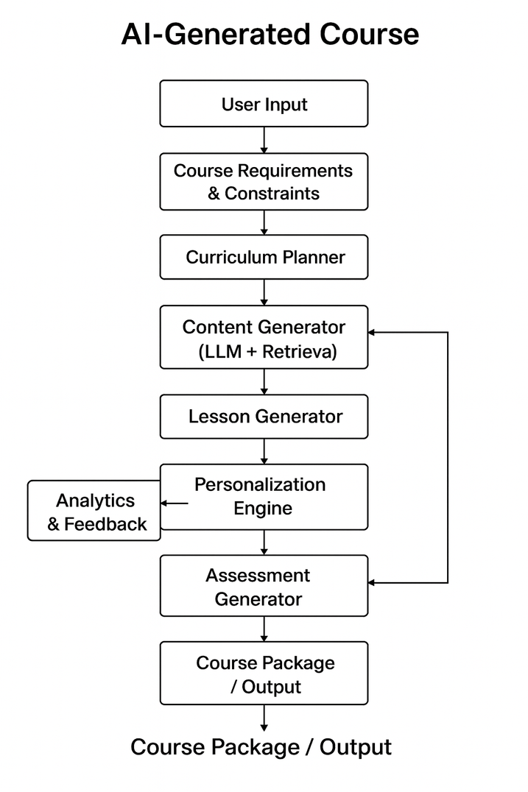
Proposed Solution - Block Diagram
Baderia Global Institute of Engineering and Management, Jabalpur
6

Slide 7

TECHNOLOGY STACK
FRONTEND
HTML,React.js,JavaScript,Tailwind css.
BACKEND
Node.js,Express.js
DATABASE
MongoDB (NoSQL)
AI INTEGRATION
OpenAI / Gemini API / Llama API
NLP-based content generation
Keyword extraction
Course structuring models
Baderia Global Institute of Engineering and Management, Jabalpur
7

Slide 8



Feasibility Study
TECHNICAL FEASIBILITY
RESOURCE FEASIBILITY
DATA AVAILABILITY
The team is proficient in JavaScript and Web Development. The MERN stack is open-source, well-documented, and widely supported by the community.
Development tools (VS Code, Git) are free. Hosting can be managed via free tiers on platforms like Vercel (Frontend) and Render (Backend).
For the 'Smart' recommendation features, we will utilize publicly available educational datasets from Kaggle to train our initial models .
Baderia Global Institute of Engineering and Management, Jabalpur
8

Slide 9
Tentative Timeline - Smart Learn Studio
THE EXECUTION OF SMARTLEARN STUDIO IS PLANNED OVER A DURATION OF FOUR MONTHS.
Month 1 - focuses on requirement analysis, UI/UX design, system architecture planning, and finalization of the MERN stack with AI integration.
Month 2 - involves core development, including frontend and backend implementation, user authentication, and database integration.
Month 3 - Cover AI-powered course generation, learning workflow development, system logic testing, and optimization.
Month 4 - Is dedicated to system testing, bug fixing, performance optimization, live deployment, and preparation of final documentation and project report.
Baderia Global Institute of Engineering and Management, Jabalpur
9

Slide 10
Expected Outcomes
SmartLearn Studio is a fully functional, deployed, full-stack web application developed using the MERN stack with AI integration.
🔗 Live Deployment Link:
https://tusharvaidya0303.github.io/Smart-Learn-Studio/index.html
The platform goes beyond a static website by providing a data-driven solution that automates and enhances the course creation and learning process using modern technologies and artificial intelligence.
Key Beneficiary Groups
• Instructors
AI-assisted course creation, structured content organization, and efficient course management.
• Students
Personalized, well-structured, and easily accessible learning experiences.
• Administrators
Centralized system control, secure data management, and scalable platform operations.
Baderia Global Institute of Engineering and Management, Jabalpur
10

Slide 11
References
References for SmartLearn Studio
Generative AI for Content & Structure (AI Course Outline Generator) This paper supports the foundational concept of using AI to create structured, educational content, which is the core of our instructor-facing feature.
( R. S. H. Al-Dmour and R. A. Abu-Shanab, "A Novel Approach for Automatic Course Content Generation Using Natural Language Processing and Machine Learning," in IEEE Access, vol. 11, pp. 117582-117593, 2023, doi: 10.1109/ACCESS.2023.3323087.)
2.Adaptive Learning and Personalization (Adaptive Curriculum Engine) This reference provides the technical and pedagogical framework for our unique Adaptive Curriculum Engine, showing how systems dynamically adjust to student performance.
Baderia Global Institute of Engineering and Management, Jabalpur
11

